Slide 1
Tips for Making Teaching Environments More Accessible for Neurodiverse Students
March 2023
Julie Tonge & Fiona Quinn – UCD Access & Lifelong Learning

Slide 2
What’s good about neurodiversity?
Diversity
New perspectives
Creative
Intelligent
Determined
Visual
Fun-loving

Slide 4
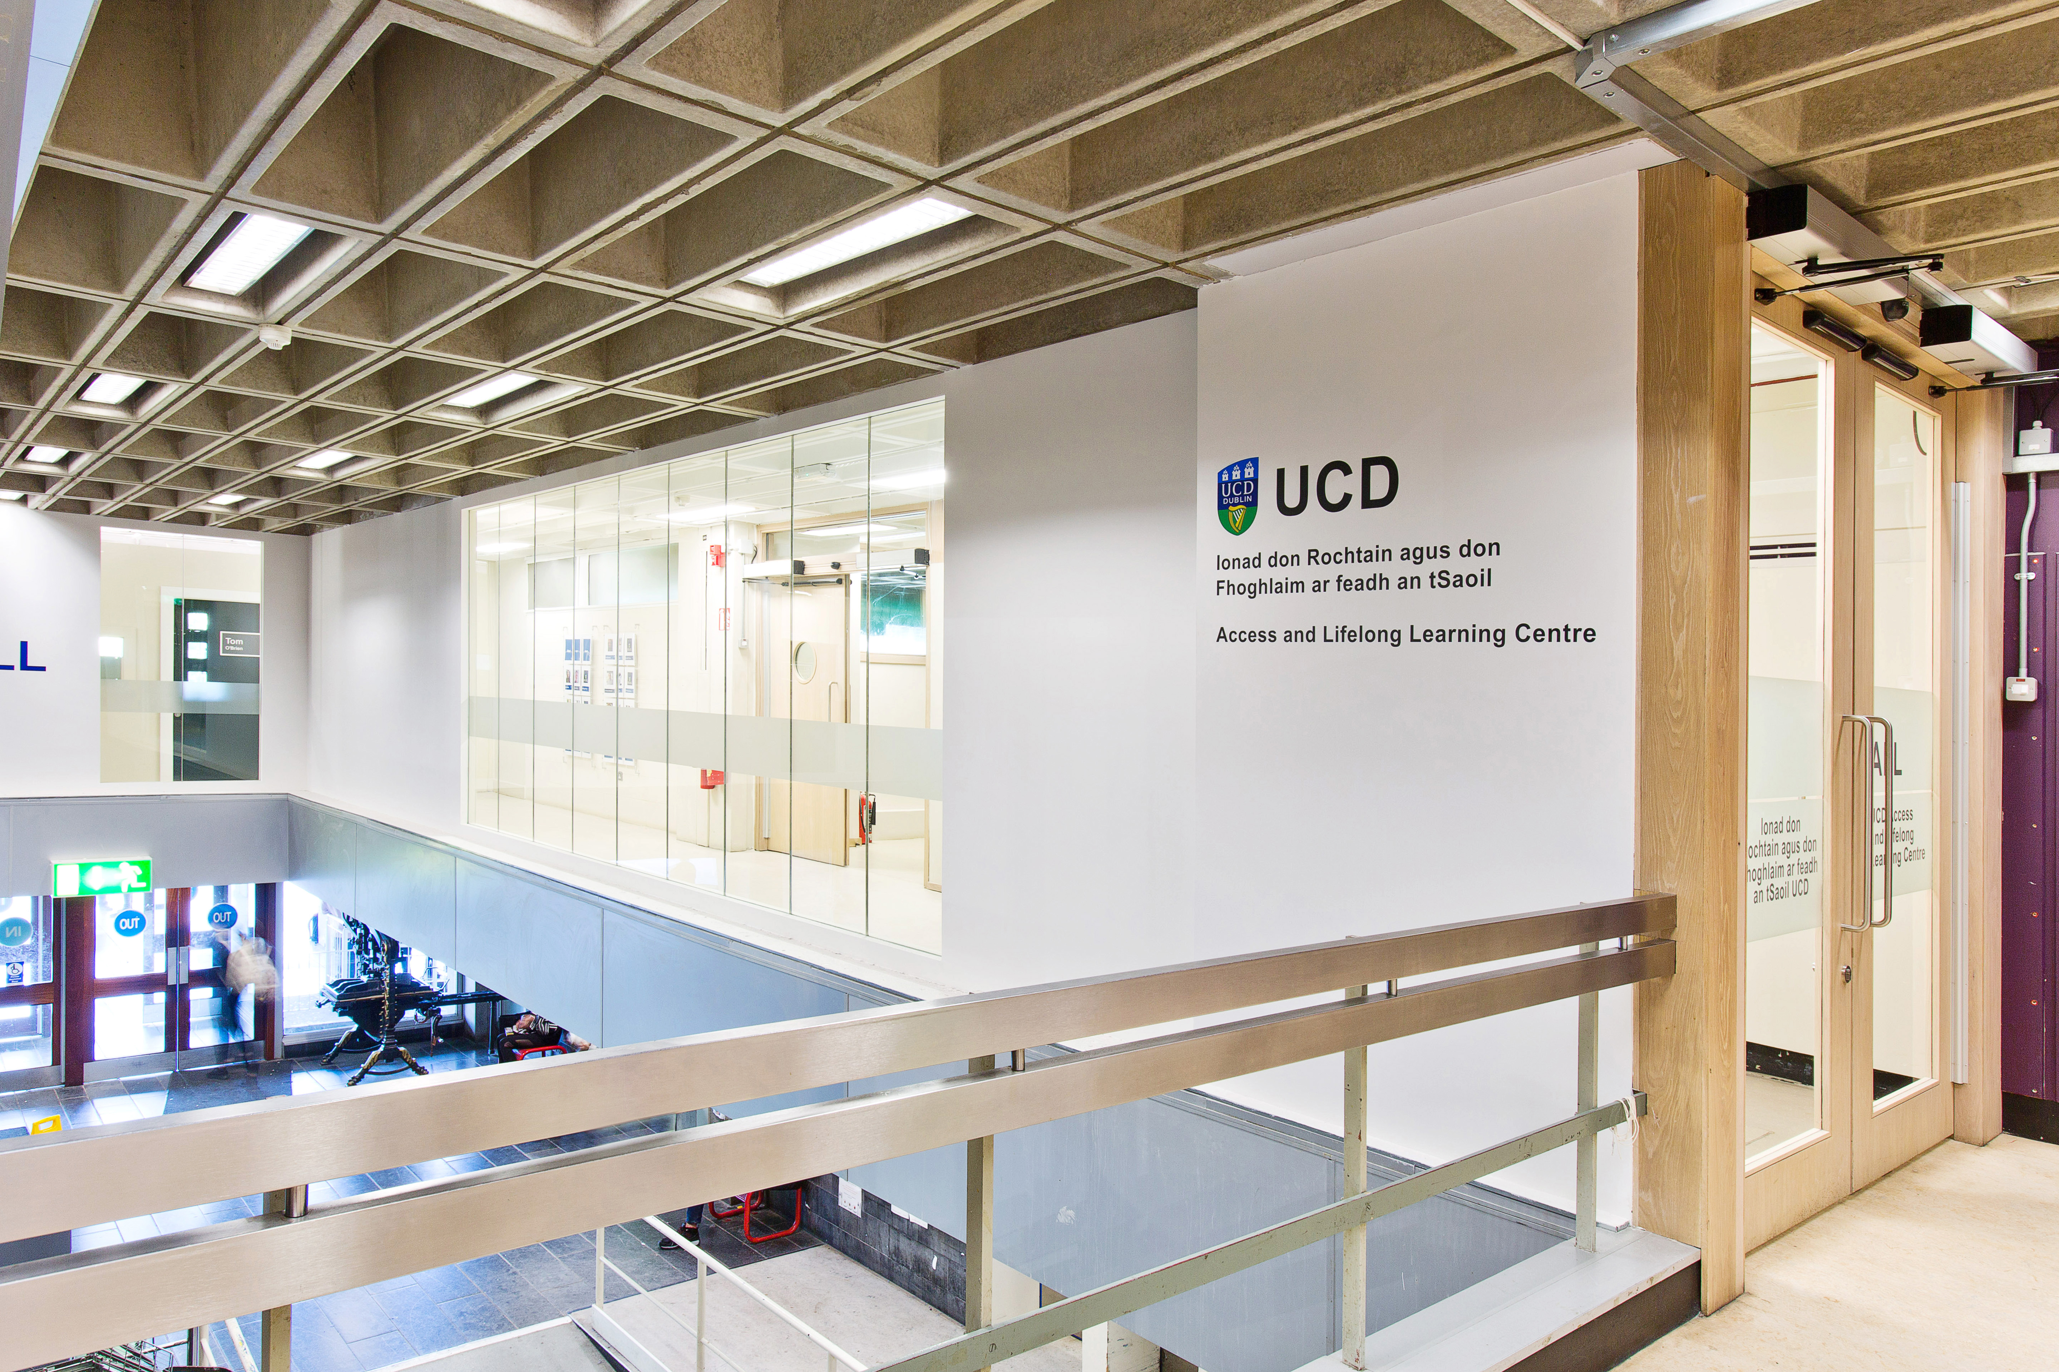
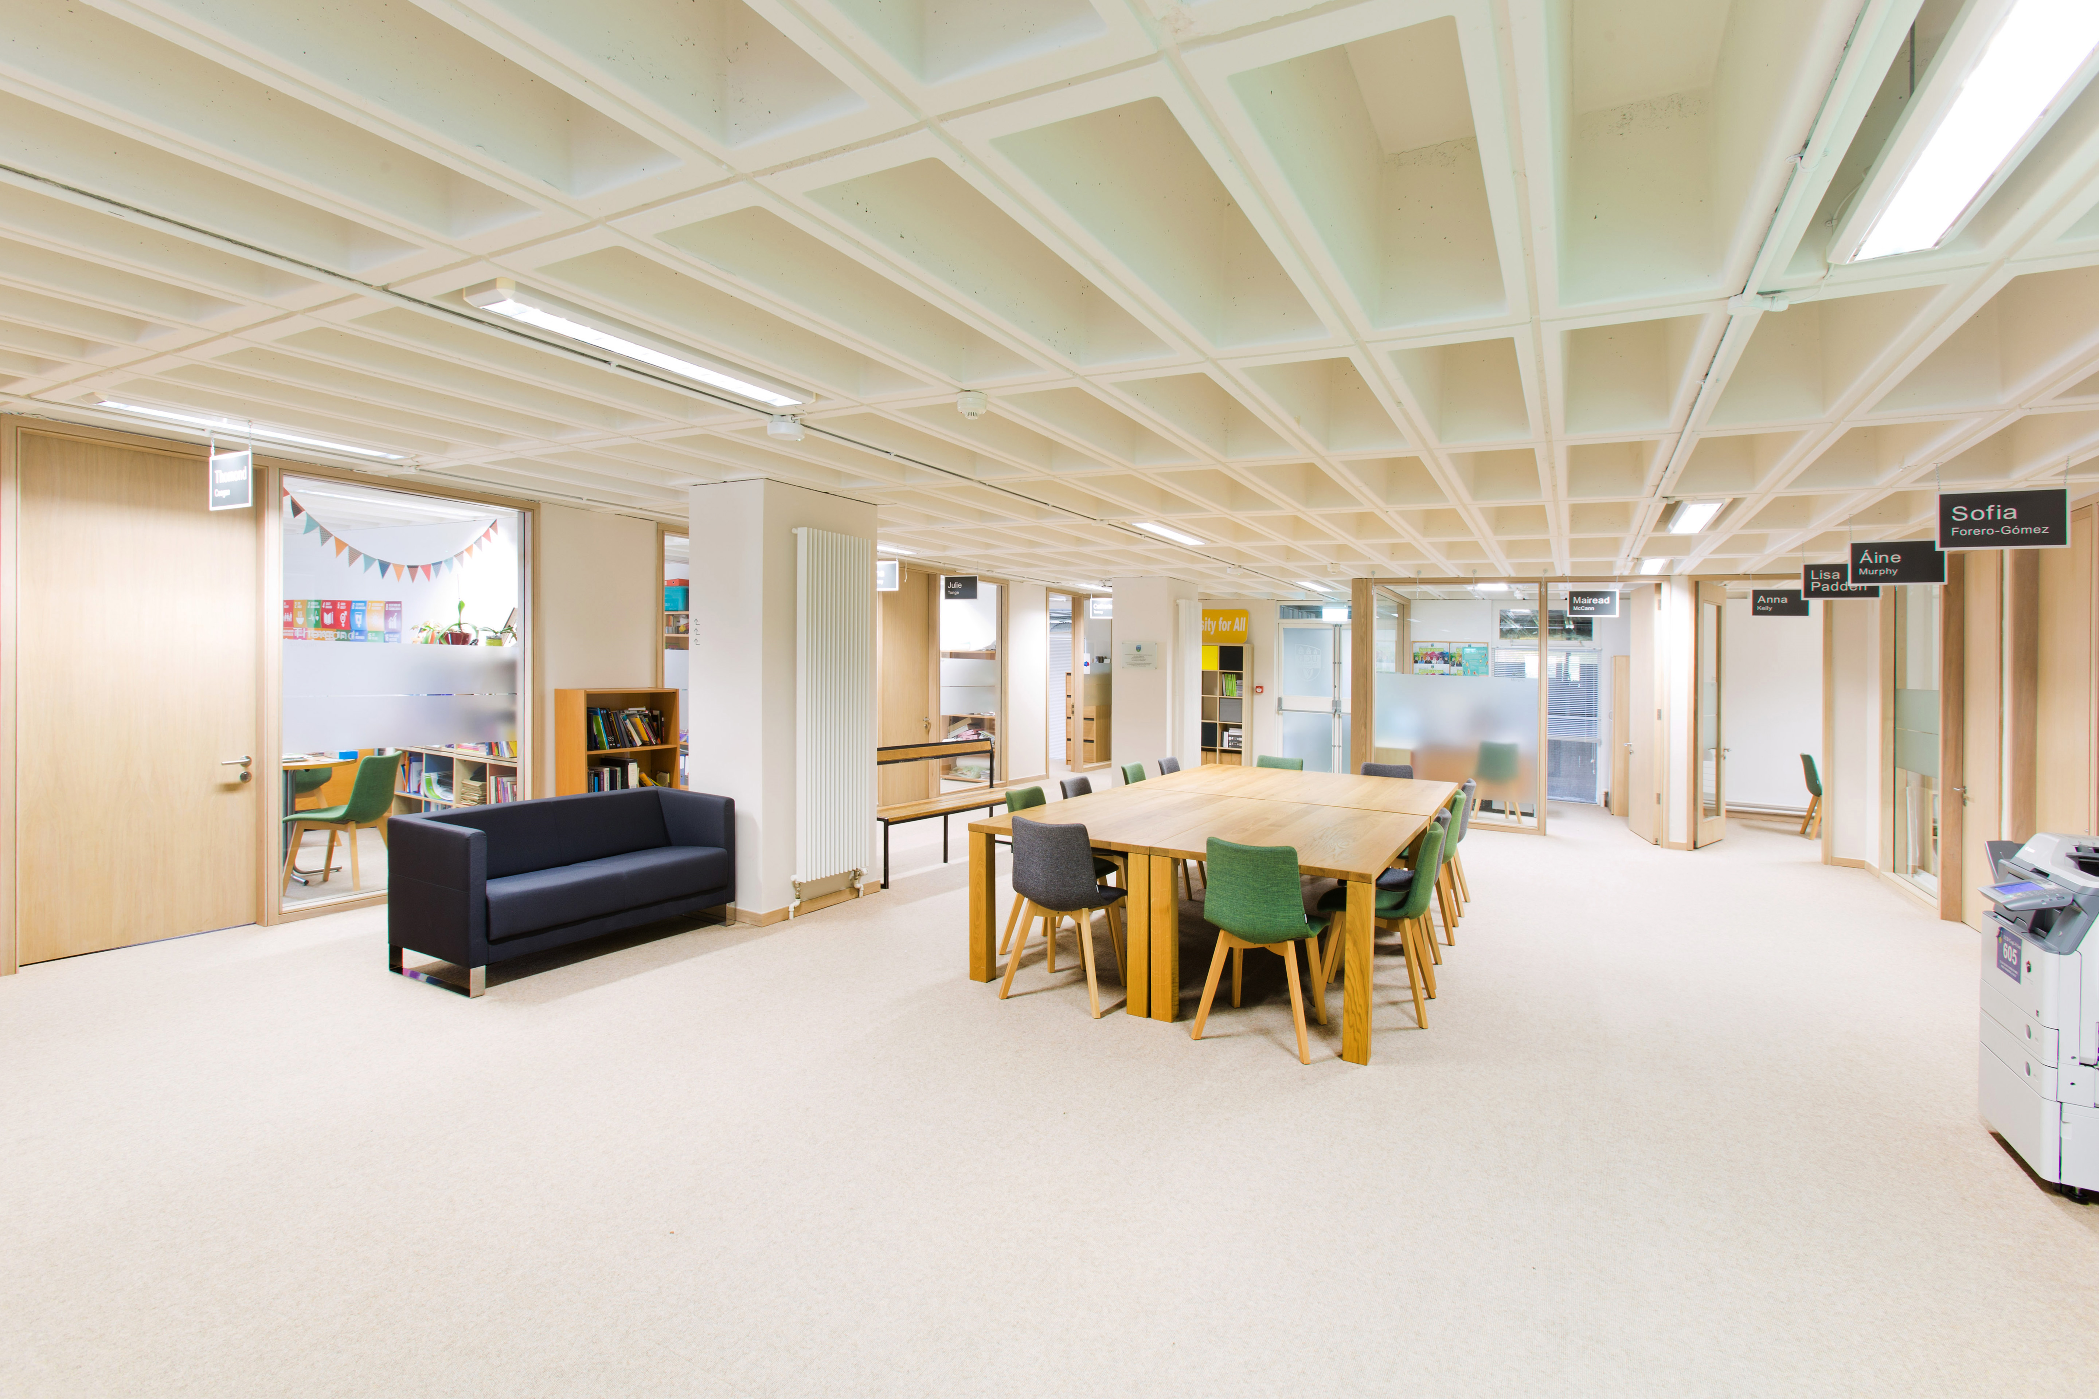
UCD Access & Lifelong Learning
The ALL Centre
James Joyce Library Building

Slide 6
Neurodiversity in UCD
Many Students will have more than one diagnosis.

Slide 8
What is a Reasonable Accommodation?
A Reasonable Accommodation is any action that alleviates a disadvantage that a person experiences due to a disability or medical condition.
Common examples include:
Additional time in exams
Smaller exam venue
Assistive Technology provision and training
Provision of lecture slides
A range of other supports may also be provided.

Slide 9
Supports for Neurodiverse students
In addition to Reasonable Accommodations students are offered a suite of supports, many of which any student can use:
Dyslexia Screening Service
Digital Ambassadors.
Academic Skills Workshops and access to online resources.
Workshops of particular interest to neurodiverse students – check out our website for upcoming events and recordings.
Assistive Technology
https://www.ahead.ie/The-AT-Hive

Slide 10
Top tips for an accessible classroom
Be Aware of students needs - some students may need to move during class or leave the class briefly. Encourage this at the beginning of your lectures.
In longer classes include a break for 5- 10 minutes.
Encourage the use of technology, many students will be using Assistive Technology in class.
Provide Lecture Recordings for use as study revision aid.
Upload lecture slides to Brightspace before the lecture, so students can read them beforehand.
Allow students to take pictures of workings during class – not all students will be able to copy it down.

Slide 11
More tips
Give students a to do list to help them keep on track.
Provide students with a clear outline of the assessments, with specific instructions, and the weighting for each component.
Give students an outline of the expectations for the class- what additional work they need to be doing outside of class and how much time they should spend on it.
Assist students to break down tasks into small chunks.
Provide a module planner and include all your deadlines
Encourage students to give feedback on what works for them.

Slide 12
Use these Accessibility Tools!
Ally for Brightspace – download your course materials in a format that works best for you.
SensusAccess – a simple file conversion tool to create files in whatever format suits e.g. you can create audio files to listen to when on the move.

Slide 13
Imbedding Wellbeing in your classroom
Encourage social activity in your classroom.
Encourage healthy habits – include these in the student To Do List!
Consider whole programme workload.
Be aware of the University Supports and encourage students to use them- e.g. Silvercloud, UCD Counselling, Student Advisers, Access and Lifelong Learning, Maths Support Centre, Clubs and Societies etc.

Slide 14
Universal Design for Learning (UDL)
Provide multiple means of representation - present your information in a variety of formats e.g. text, image, video etc.
Provide multiple means of action and expression – allow students to express what they know in different ways e.g. choice of assessment.
Provide multiple means of engagement – use different methodologies to motivate students e.g. groupwork and individual projects.
Complete the Digital Badge in Universal Design for Teaching & Learning.

Slide 15
disability@ucd.ie

